Slide 1
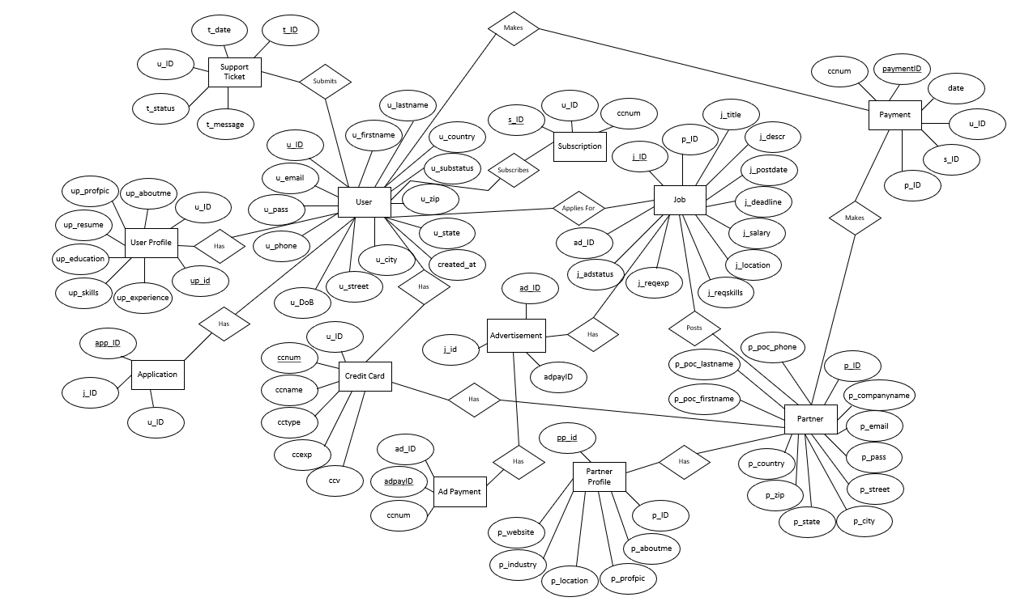
Conceptual ER Diagram
Team 1
Jobster

Slide 2
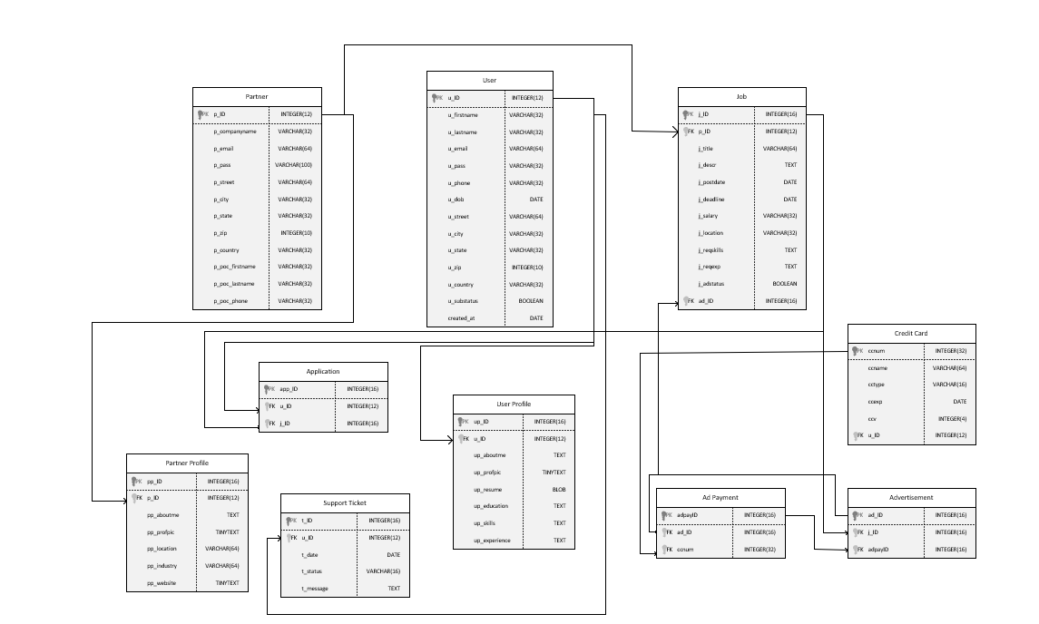
Logical ER Diagram R1
Team 1
Jobster

Slide 3
REVISION NOTES:
Conceptual Diagram modified slightly to change user profile and partner profile primary key from TINYTEXT to INTEGER
A few corrections to data types for consistency with database.
created_at attribute added to User table

